Slide 1
Chapter 2: Introduction to Relational Model

Slide 2

Example of a Relation
attributes
(or columns)
tuples
(or rows)

Slide 3
Attribute Types
The set of allowed values for each attribute is called the domain of the attribute
Attribute values are (normally) required to be atomic; that is, indivisible
The special value null is a member of every domain. Indicated that the value is “unknown”
The null value causes complications in the definition of many operations

Slide 4
Relation Schema and Instance
A₁, A₂, …, A_{n} are attributes
R = (A₁, A₂, …, A_{n} ) is a relation schema
Example:
instructor = (ID, name, dept_name, salary)
Formally, given sets D₁, D₂, …. D_{n} a relation r is a subset of
D₁ x D₂ x … x D_{n}
Thus, a relation is a set of n-tuples (a₁, a₂, …, a_{n}) where each a_{i} ∈ D_{i}
The current values (relation instance) of a relation are specified by a table
An element t of r is a tuple, represented by a row in a table

Slide 5

Relations are Unordered
Order of tuples is irrelevant (tuples may be stored in an arbitrary order)
Example: instructor relation with unordered tuples

Slide 6
Keys
Let K ⊆ R
K is a superkey of R if values for K are sufficient to identify a unique tuple of each possible relation r(R)
  Example: {ID} and {ID,name} are both superkeys of instructor.
Superkey K is a candidate key if K is minimal
Example: {ID} is a candidate key for Instructor
One of the candidate keys is selected to be the primary key.
  which one?
Foreign key constraint: Value in one relation must appear in another
  Referencing relation
  Referenced relation
  Example – dept_name in instructor is a foreign key from instructor referencing department

Slide 7

Schema Diagram for University Database

Slide 8
Relational Query Languages
Query language is a language in which user request information to database.
It can be procedural and non-procedural, or declarative
“Pure” languages:
  Relational algebra
  Tuple relational calculus
  Domain relational calculus
The above 3 pure languages are equivalent in computing power
We will concentrate in this chapter on relational algebra
Relational algebra:
  is a procedural query language that take 1 or 2 relations as input and produce a new relation as output
  Fundamental operations are select, project, union, set difference, Cartesian product, rename.

Slide 9
Relational Algebra
Six basic operators
  select: σ
  project: ∏
  union: ∪
  set difference: –
  Cartesian product: x
  rename: ρ
The operators take one or two relations as inputs and produce a new relation as a result.

Slide 10
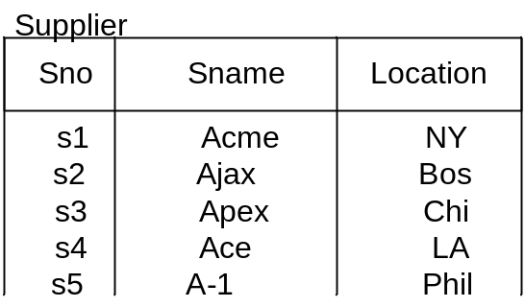
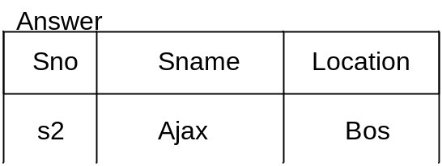
Select Operation – selection of rows (tuples)
Selection returns a subset of the rows of a table.
Syntax:
select <table_name> where <condition>
/* the <condition> must involve only
columns from the indicated table */
alternatively
σ _{<condition>} (table_name)
Find all suppliers from Boston.
Select Supplier
where Location = ‘Bos’
σ _{Location = ‘Bos’} (Supplier)

Slide 11

Select Operation – selection of rows (tuples)
Selects tuples that meets a given predicate
If relation r then
σ_{A=B ^ D > 5} (r)

Slide 12

Project Operation
Selection of columns or a subset of attributes
∏_{A,C} (r)

Slide 13

Union of two relations
Relations r, s:
r ∪ s:

Slide 14

Set difference of two relations
Relations r, s:
r – s:

Slide 15

Set intersection of two relations
Relation r, s:
r ∩ s
Note: r ∩ s = r – (r – s)

Slide 16

joining two relations -- Cartesian-product
Relations r, s:
r x s:

Slide 17
Cartesian-product – naming issue
B
Relations r, s:
r.B
s.B
r x s:

Slide 18
Renaming a Table
Allows us to refer to a relation, (say E) by more than one name.
ρ _{x} (E)
returns the expression E under the name X
Relations r
r.A r.B s.A s.B
r x ρ _{s} (r)
α
α
β
β
1
1
2
2
α
β
α
β
1
2
1
2

Slide 19

Composition of Operations
Can build expressions using multiple operations
Example: σ_{A=C} (r x s)
r x s
σ_{A=C} (r x s)

Slide 20
Joining two relations – Natural Join
Let r and s be relations on schemas R and S respectively.
Then, the “natural join” of relations R and S is a relation on schema R ∪ S obtained as follows:
  Consider each pair of tuples t_{r} from r and t_{s} from s.
  If t_{r} and t_{s} have the same value on each of the attributes in R ∩ S, add a tuple t to the result, where
    t has the same value as t_{r} on r
    t has the same value as t_{s} on s

Slide 21

Natural Join Example
Relations r, s:
Natural Join
  r s
∏ _{A, r.B, C, r.D, E} (σ _{r.B = s.B ˄ r.D = s.D} (r x s)))

Slide 22
Notes about Relational Languages
Each Query input is a table (or set of tables)
Each query output is a table.
All data in the output table appears in one of the input tables
Relational Algebra is not Turning complete
Can we compute:
  SUM
  AVG
  MAX
  MIN

Slide 23
Summary of Relational Algebra Operators
Symbol (Name) Example of Use
σ
(Selection) ^{σ} salary > = 85000 ^{(instructor)}
Return rows of the input relation that satisfy the predicate.
Π
(Projection) ^{Π} ID, salary ^{(instructor)}
Output specified attributes from all rows of the input relation. Remove duplicate tuples from the output.
x
(Cartesian Product) instructor x department
Output pairs of rows from the two input relations that have the same value on all attributes that have the same name.
∪
(Union) ^{Π} name ^{(instructor) ∪ Π} name ^{(student)}
Output the union of tuples from the two input relations.
-
(Set Difference) ^{Π} name ^{(instructor)} ^{-- Π} name ^{(student)}
Output the set difference of tuples from the two input relations.
⋈
(Natural Join) instructor ⋈ department
Output pairs of rows from the two input relations that have the same value on all attributes that have the same name.

Slide 24
End of Chapter 2

